Slide 1


MANAGING REVENUE CHALLENGES DURING COVID
JOY CHAKRABORTY
CHIEF OPERATING OFFICER
26th June 2020
FICCI – Rebooting Hospitals

Slide 2
Introduction
A typical “Black Swan” event
COVID-19 took the world by complete surprise
This Pandemic is unprecedented in its sheer scale and loss
India Faces a Dual Challenge …
Notes:
A black swan is an unpredictable event that is beyond what is normally expected of a situation and has potentially severe consequences. Black swan events are characterized by their extreme rarity, their severe impact, and the widespread insistence they were obvious in hindsight.

Slide 3
Sharp drop in Revenue
Government regulated rates
Revenue losses of up to 50-60 %
Short term operating losses ~
  Rs 4500 Crs for a month Rs 13,400 Crs for a quarter if revenues are at 50 % (occupancy of 35 %)
~ 50-60% drop in bed occupancy
~ 70 – 80 % drop in footfall, test volumes
Est .it will take at least 3 quarters to return to normalcy
The revenue in FY 21 is expected to be lower by 20-35% (compared to FY 20)
  resulting in early single digit or negative EBITDA for the full year with annual ROCEs estimated at -5 to -15%
EY-FICCI study titled, “COVID-19 impact assessment for private healthcare sector and key financial measures recommendations for the sector.”
https://www.business-standard.com/article/economy-policy/covid-19-impact-hospital-stocks-take-a-hit-as-number-of-patients-falls-120042301410_1.html

Slide 4
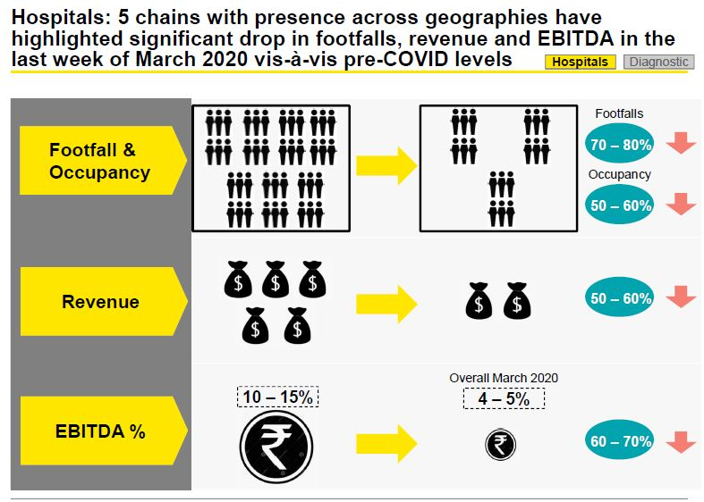
EY-FICCI study titled, “COVID-19 impact assessment for private healthcare sector and key financial measures recommendations for the sector.”

Slide 5
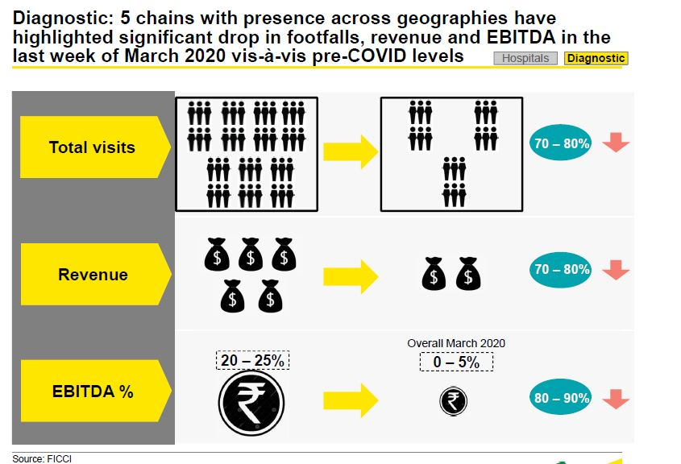
EY-FICCI study titled, “COVID-19 impact assessment for private healthcare sector and key financial measures recommendations for the sector.”

Slide 6
Heavy Investment by the Healthcare sector
Working with Full manpower
Stocking up on consumables and equipment to ensure safety of staff and patients
  80% of the sector’s costs are fixed
https://economictimes.indiatimes.com/markets/stocks/news/coronavirus-impact-on-healthcare-sector/articleshow/75136714.cms?from=mdr
https://www.business-standard.com/article/economy-policy/covid-19-impact-hospital-stocks-take-a-hit-as-number-of-patients-falls-120042301410_1.html

Slide 7


Think Outside the Box!
Notes:
To maintain revenue cycle business continuity amid the pandemic, hospitals should focus on five key strategies

Slide 8

Add ‘Revenue Earning’ Service lines
Home Isolation Care for COVID 19 positive patients
  According to the Health Ministry’s June 13 guidelines, mild cases of Covid-19 can be managed at home if the residence meets the requisite conditions of enough space, availability of a constant caregiver and link with a hospital
  Different packages
    includes medical kits comprising a thermometer and oxygen saturation device, home delivery of medicines, consultation with doctors online or over the phone, and nurse-supervised monitoring of vitals up to twice a day
Chronic Disease Management
  Diabetes, Hypertension, Asthma – all are co-morbidities which put patients at higher risk with COVID 19
  Global Chronic Disease Management Market to Reach USD 10.3 Billion by 2024
https://www.bloombergquint.com/business/private-hospitals-target-mildly-ill-covid-19-patients-with-at-home-care-plans
https://www.beckershospitalreview.com/news-analysis/10-best-practices-for-increasing-hospital-profitability.html
Notes:
Meet with local physicians about their needs
hospitals need to be careful to do their homework on the expected profitability and ROI for any new lines added, especially in a market where access to the funds required to invest in new service lines may be tight.

Slide 9
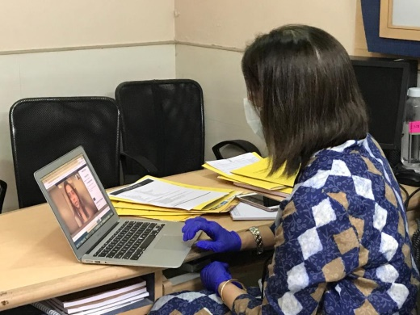
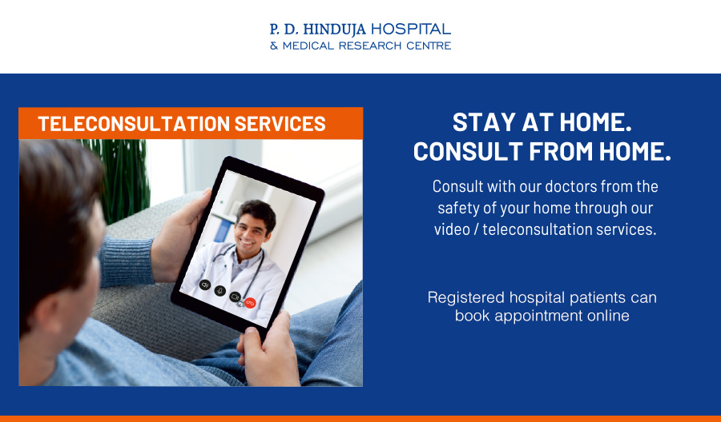
Re-configure for Easier Patient access
Connect digital access capabilities to all areas related to attracting and retaining patients
  Tele- consultation
  Online Registration
  Online Payments
  Online appointments
  Remote Check –in

Slide 10
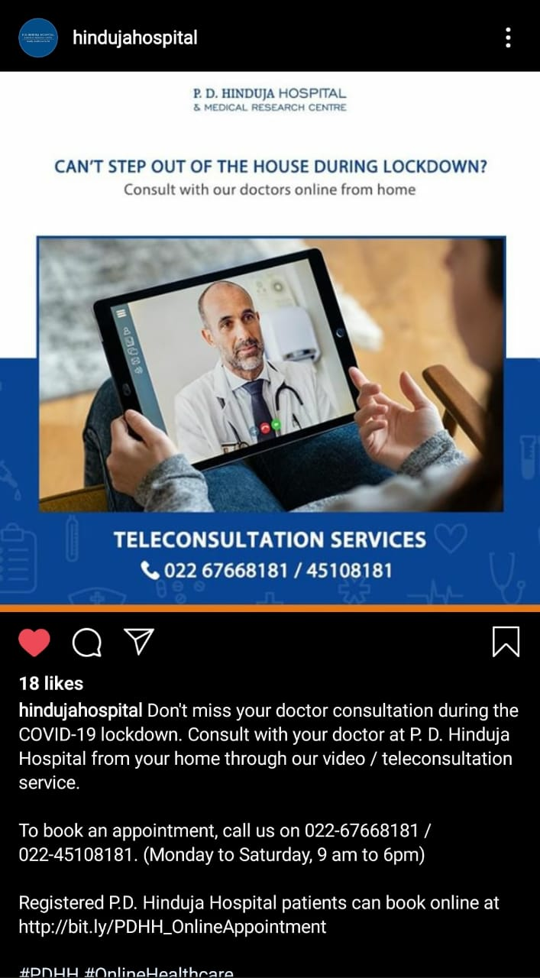

Use of Digital marketing to create awareness of services
Digital Marketing
Posts on Social Media

Slide 11
Resource Optimization
Reduce supply costs by better managing vendors
Involve physicians in cost reduction efforts
Re-look at efficient OT utilization
Partnering with local physicians to reduce competition for outpatient cases
Grow case volume by attracting new physicians to your facility
Map your upstream suppliers several tiers back
Understand your critical vulnerabilities and take action to spread the risk
  Redesign with second sources
  Redesign to source locally
Renegotiate Contracts

Slide 12
Consider outsourcing the management of some services
Effective workforce management strategy
Consider outsourcing the management of some services
  Food
  Laundry services
  Some clinical services ~ Diagnostic
  Information technology
  Human resources
Reduce Staffing Costs using data to drive staffing decisions
  Flexi hours
  Work From Home
  Part time employees
Based on 3 components
Health & Safety of Employees
Managing patient volume fluctuations
Cross-training staff to work in different areas

Slide 13
In addition Government action for Urgent Financial Stimulus will help the situation
Liquidity infusion
Indirect tax reliefs/ exemptions/ waivers
Income tax benefits and deferment of statutory liability payments
Rebate on commercial rate of power for a stipulated period
EY-FICCI study titled, “COVID-19 impact assessment for private healthcare sector and key financial measures recommendations for the sector.”
Notes:
Liquidity infusion
Short term interest free/ concessional interest loans to address the operating losses expected for the quarter and immediate 100% release of dues locked with central and state government authorities
Indirect tax reliefs/ exemptions/ waivers
like- recoup amount equivalent to ineligible GST credits paid on procurements for a stipulated period; Customs duty / GST exemption on essential medicines, consumables and devices for treatment of COVID patients; Waiver or reduction of health cess on medical devices, Extension of time under the EPCG scheme etc.
Income tax benefits and deferment of statutory liability payments
without interest, penalty for a stipulated period (3-6 months)
Rebate on commercial rate of power for a stipulated period

Slide 14
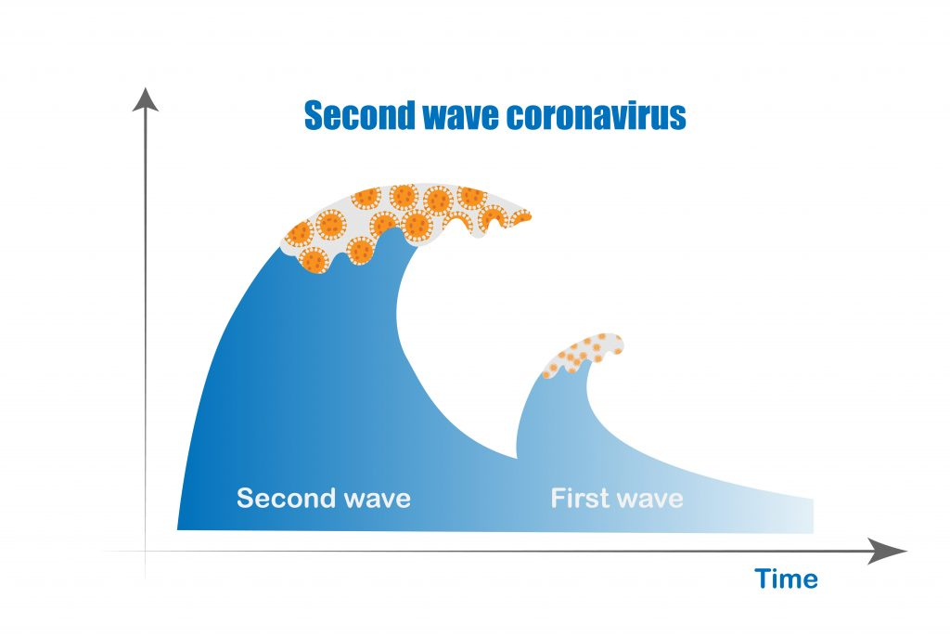
Prepare for a second wave
Have an Emergency Preparedness plan ready
Sufficient PPE on hand to for at least one year
Optimizing contact tracing efforts
Maintaining facilities so they are as safe for patients requiring COIVD and other Healthcare
Maintaining capacity at Hospitals
Notes:
With potential of a second COVID-19 wave…
Have an Emergency Preparedness plan
- Less time and money will be spent on creating infrastructure; procuring last minute PPE and consumables at increased rates
Have sufficient personal protective equipment (PPE) on hand to protect staff and patients for at least one year
Optimizing contact tracing efforts that identify people who have had contact with a person who tests positive for COVID-19
Maintaining facilities so they are as safe as possible both for patients needing help for the virus or other healthcare concerns
Maintaining capacity at Hospitals so teams can easily scale operations up or down to meet the demand for care anticipated in a second wave.

Slide 15

Learn to Live with Coronavirus
Notes:
Accept the New Normal … Adapt
Thank you

